Slide 1
ETL introduction & design patterns

Slide 2
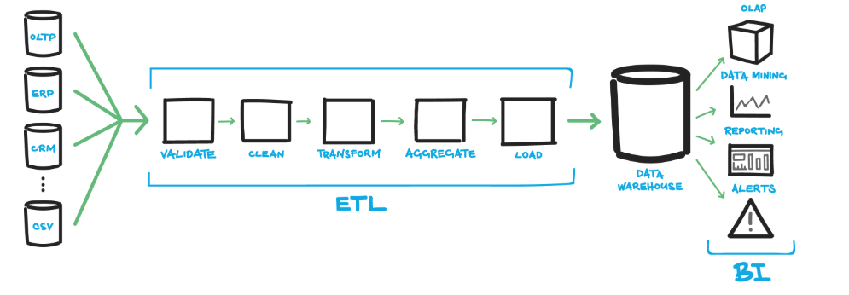
What is ETL?
ETL stands for Extract, Transform and Load. An ETL tool/program extracts the data from different data source systems, transforms the data like applying calculations, concatenate, etc. and then load the data to Data Warehouse/Data lake system

Slide 3
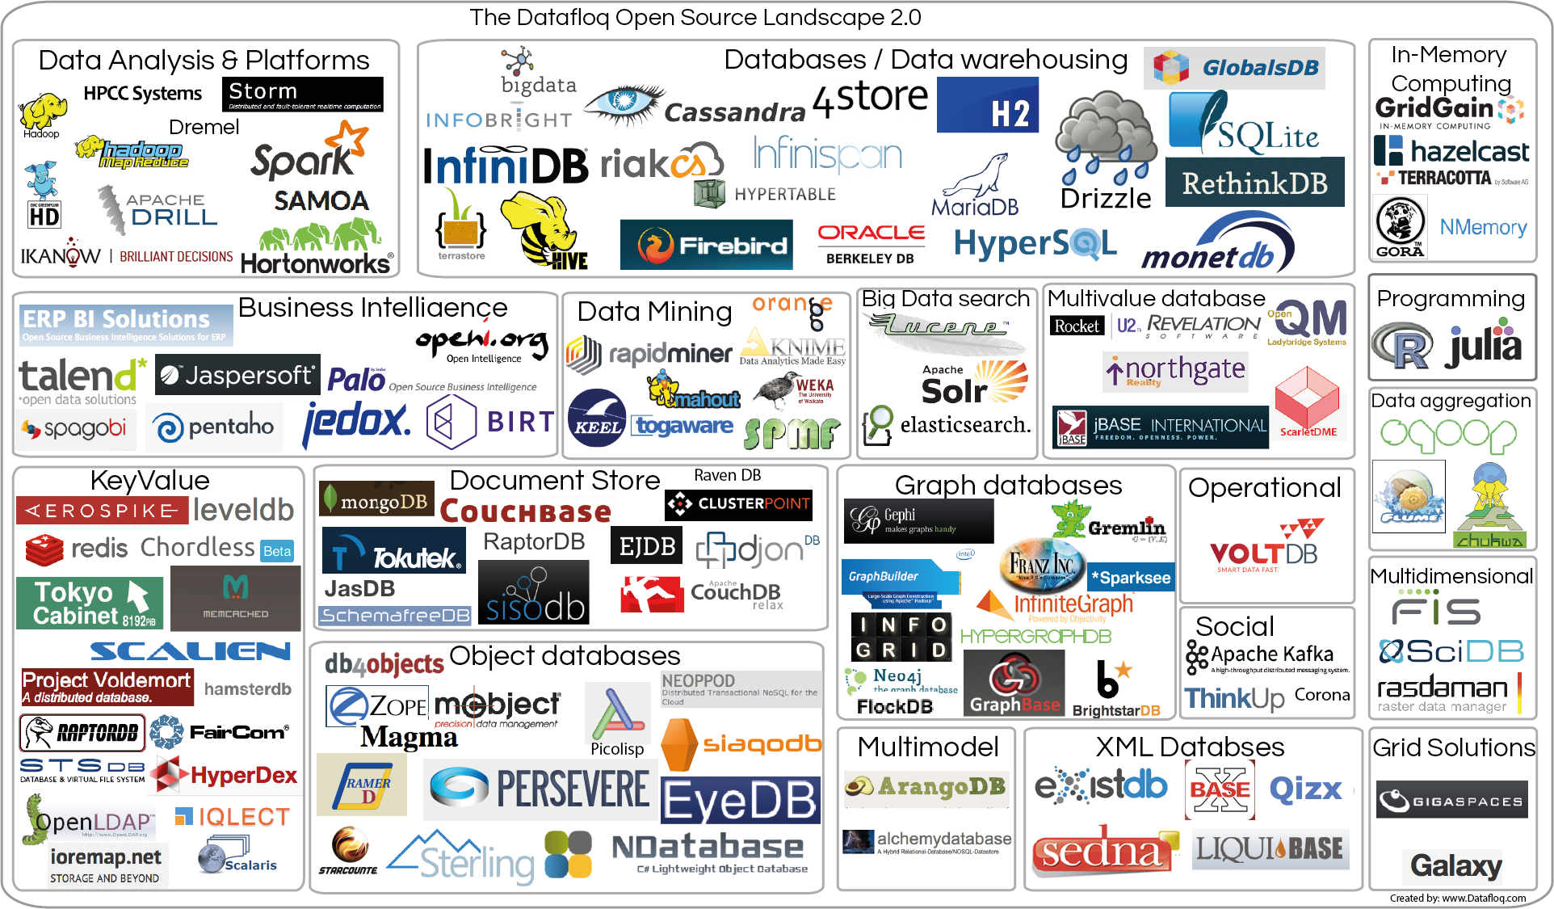
Some Data handling technologies

Slide 4
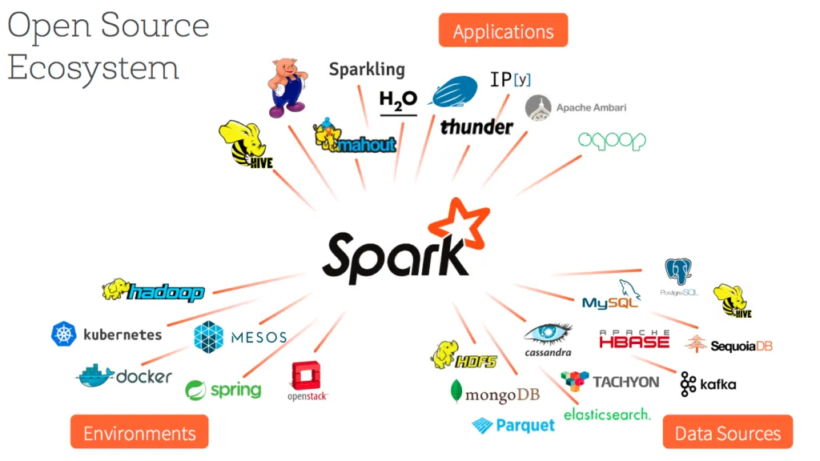
Spark ecosystem

Slide 5
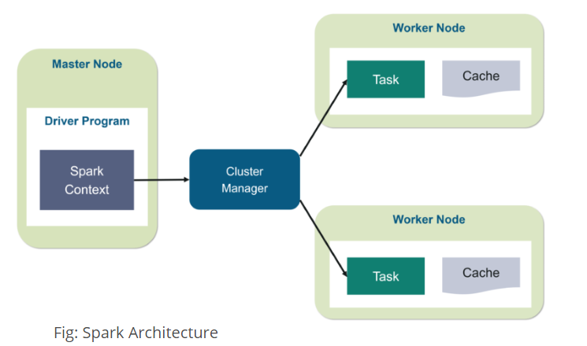
Spark Architecture
The Apache Spark framework uses a master–slave architecture that consists of a driver, which runs as a master node, and many executors that run across as worker nodes in the cluster.

Slide 6
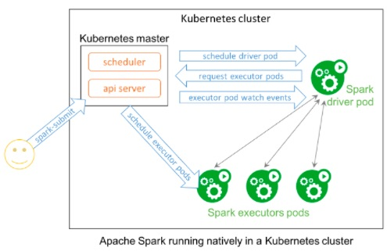
Spark on Kubernetes
https://weidongzhou.wordpress.com/2018/04/29/running-spark-on-kubernetes/

